Slide 1
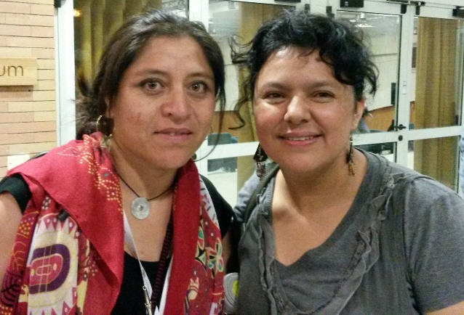
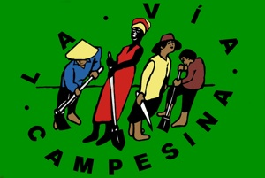

Slide 2
European Coordination of La Via Campesina
small and middelscale farmers of Europe
26 memberorganisations in 18 European countries
La Via Campesina, global movement
200 million members.

Slide 3
70% of the worldpopulation eats food produced by smallscale foodproducers
50% of the worldpopulation produces this food
30% of the natural resources is used for production
the food they produce is healthy and pure
30% of the worldpopulation eats food produced by agro-industrial producers
70% of the natural resources is used for production (in other regions)
60% of the production is wasted before it reaches the mouth of the eater
the foodproducts are responsible for obese, cardio-vasculair diseases and cancer

Slide 4
Food system actors and their activities
Input industry
Farmers, fishermen
Traders, processors
Food industry
Retailers, food service
Con-summers
Waste process, sewage
Subsistence farmers

Slide 5
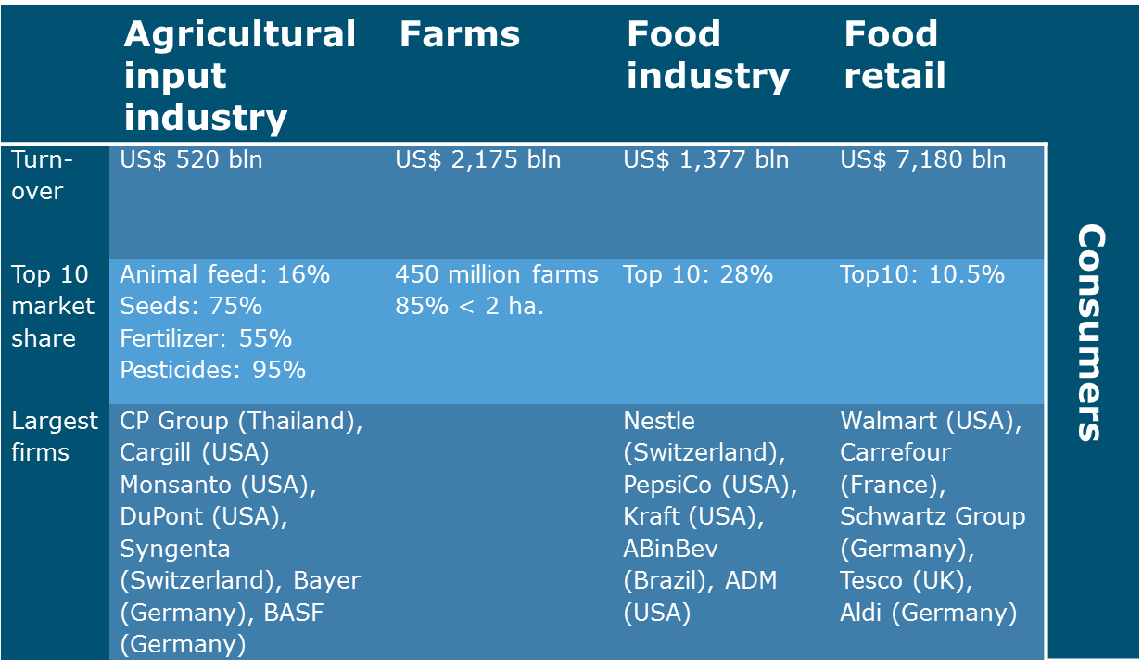

Slide 6
Average farmsize in EU:
15 old memberstates: 24ha
12 new memberstates: 7 ha
Global level: 85% < 2ha
In EU since 2005 25% of the farmers has stopped farming
Average age EU farmers is 50+

Slide 7
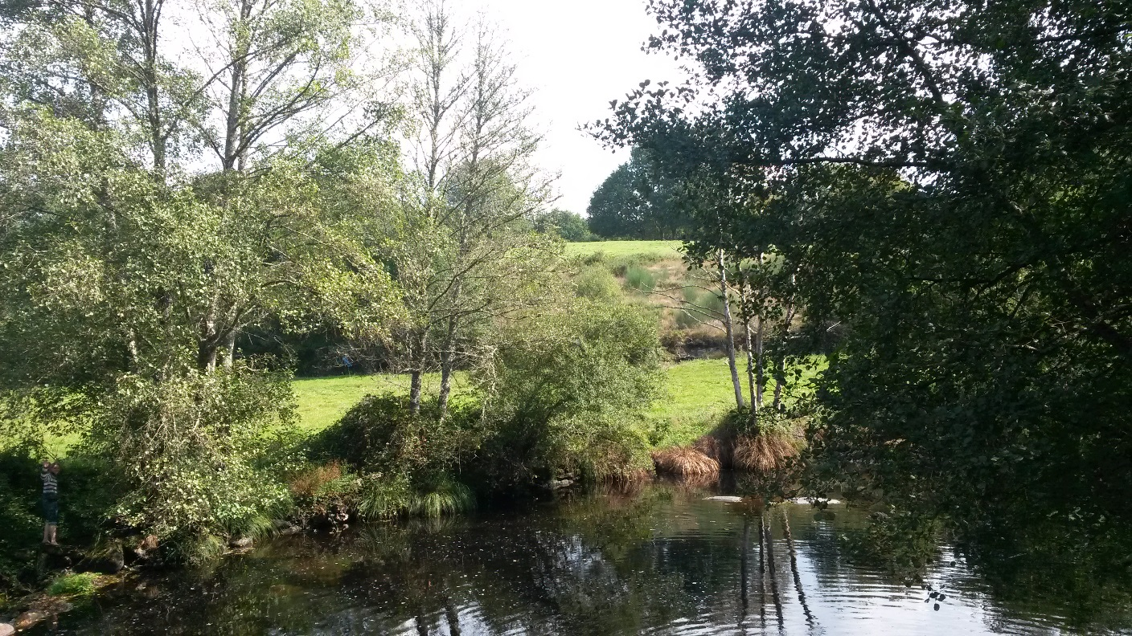
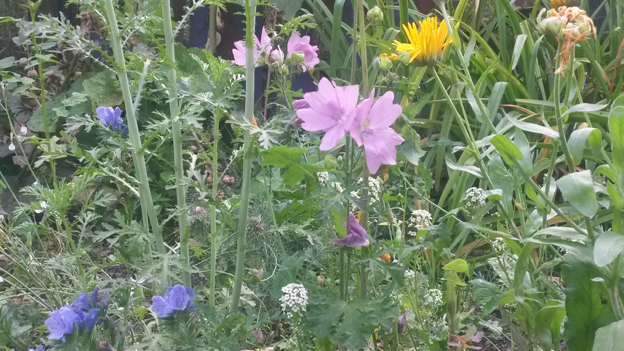
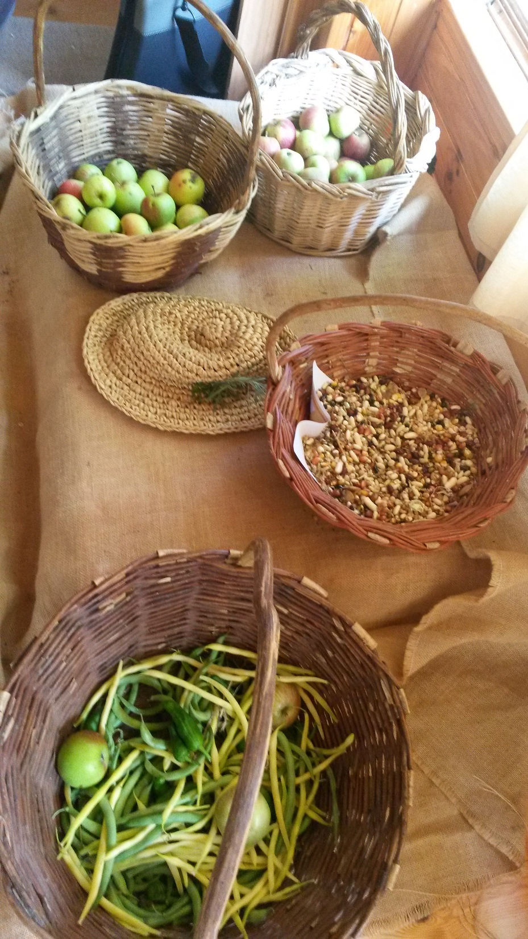
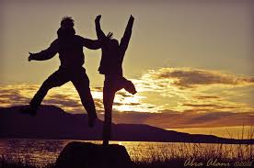
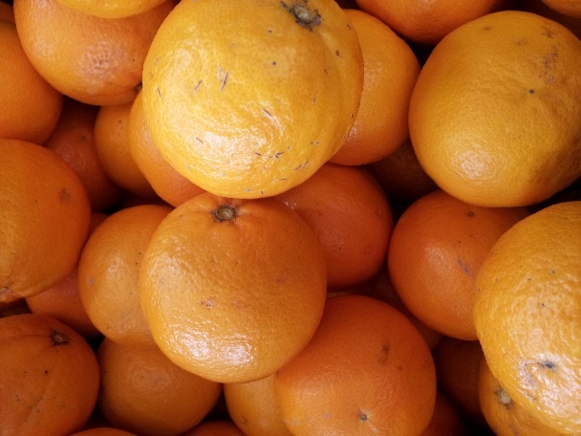
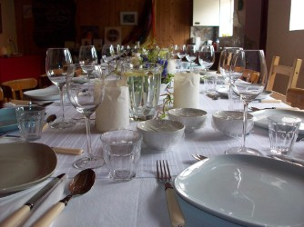
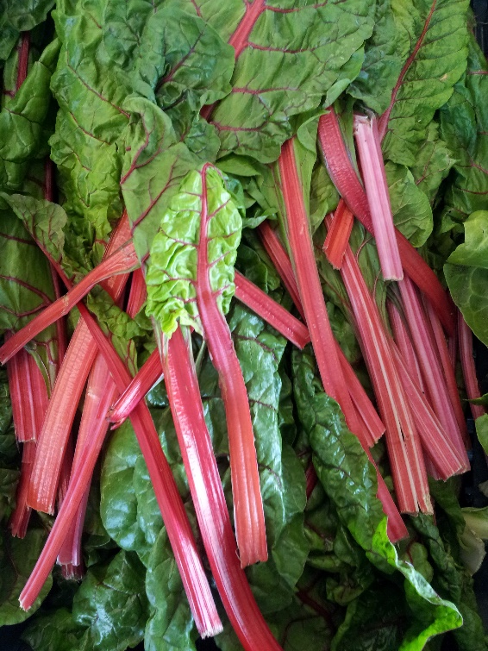
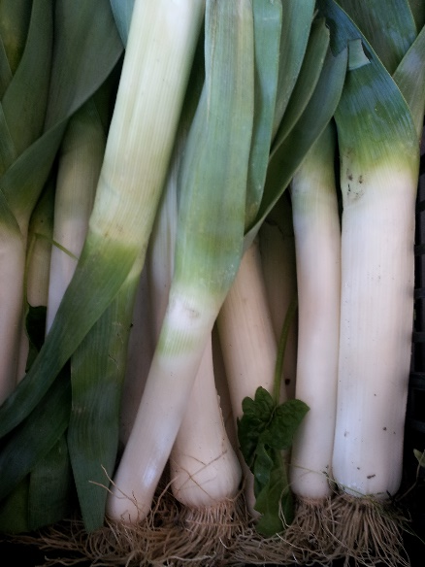
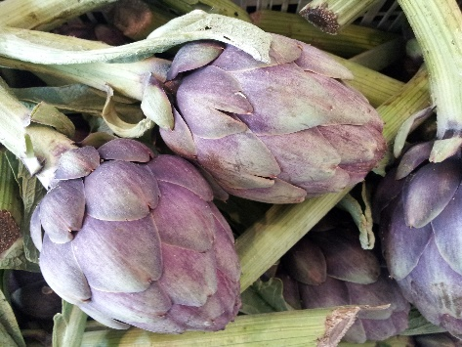

Slide 8
Agroecology is political;
challenge and transform structures of power in society
put the control of seeds, biodiversity, land and territories, waters, knowledge, culture and the commons in the hands of the peoples who feed the world

Slide 9
To achieve foodsovereignty
Agro-ecology
A model of food production-processing-distribution-markets-social networks
Autonomy and relation
Holistic and political

Slide 10
Autonomy
-Seeds
-Animal feed
- Low tech-tools
Economical (independent of subsidies etc)
Political

Slide 11
Autonomy
Acces to land and water
Equal rights for women
Youth should have knowledge and acces and benefit

Slide 12
Relation
Within communities
With consumers
With cities
With mother nature

Slide 13
forum held in Mali, February 2015
More than 200 people representing organizations of:
peasants, indigenous people, agricultural workers, artisanal fisherfolks, nomadic pastoralists, consumers and other urban people
They met to develop joint strategies to promote agroecology and defend it from corporate co-optation.

Slide 14
“agroecology is at a crossroads”
-many multilateral institutions, governments, universities and research centers, some NGOs, corporations and others, finally recognized agroecology
-redefine it as a narrow set of technologies, to offer some tools that appear to ease the sustainability crisis of industrial food production, while the existing structures of power remain unchallenged.”

Slide 15
We must transform the foodsystem:
build our own local food systems that create new rural-urban links,
based on truly agroecological food production by peasants, artisanal fishers, pastoralists, indigenous peoples, urban farmers, etc.

Slide 16
Examples different types of selling and distribution
Romania: markets and boxes
Thailand: rice-cooperative
Norway: processing and directselling on the farm
Italy: cooperative shop in the city
Spain: public procurement
France: participatory certification
Netherlands: initiatives al around

Slide 17
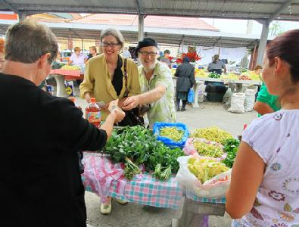
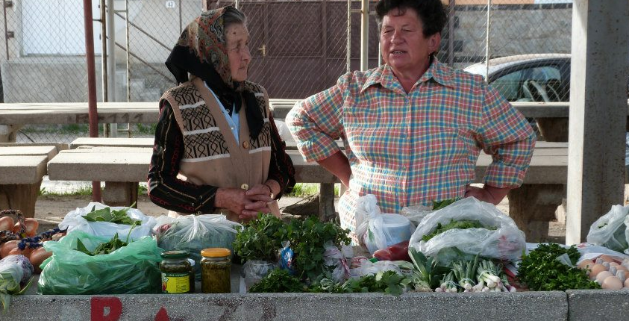
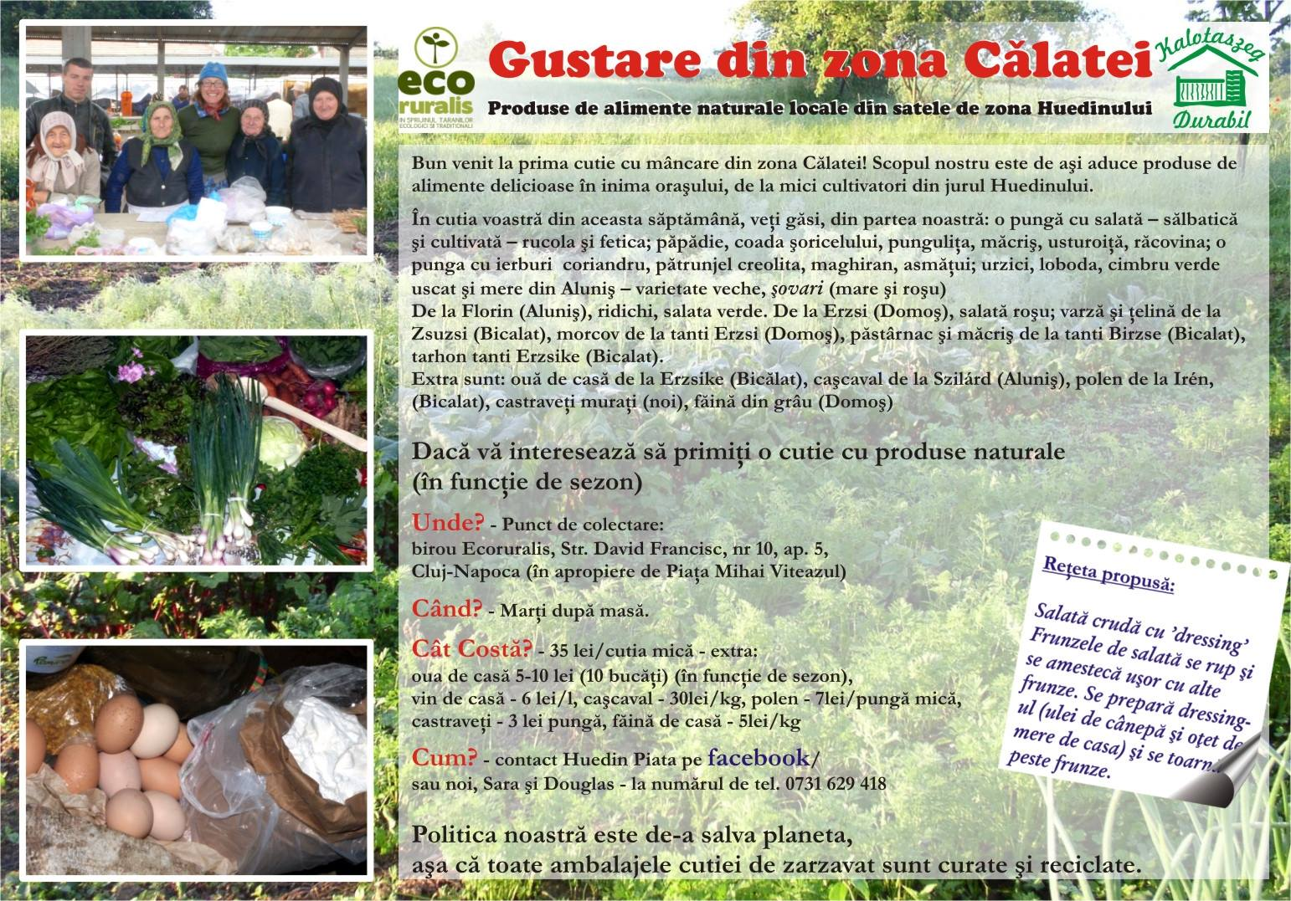
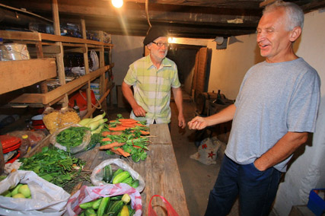

Slide 18
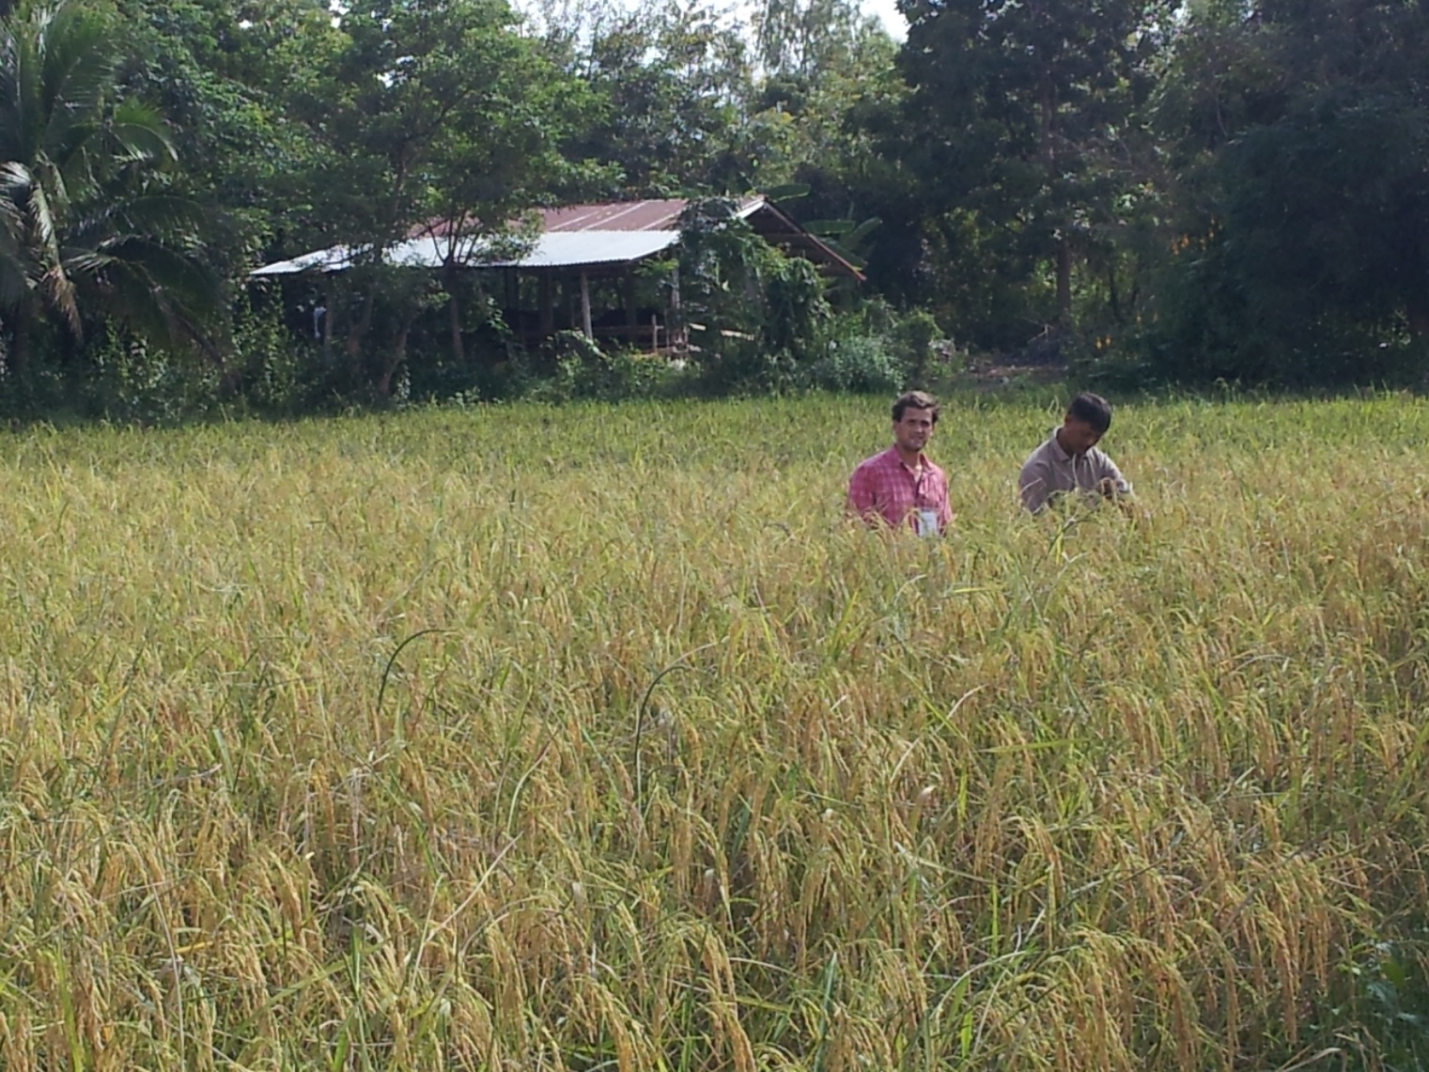
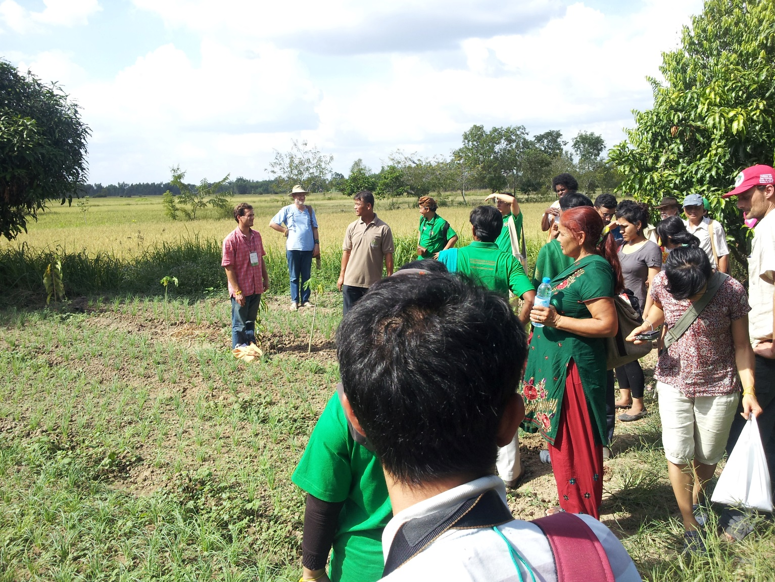
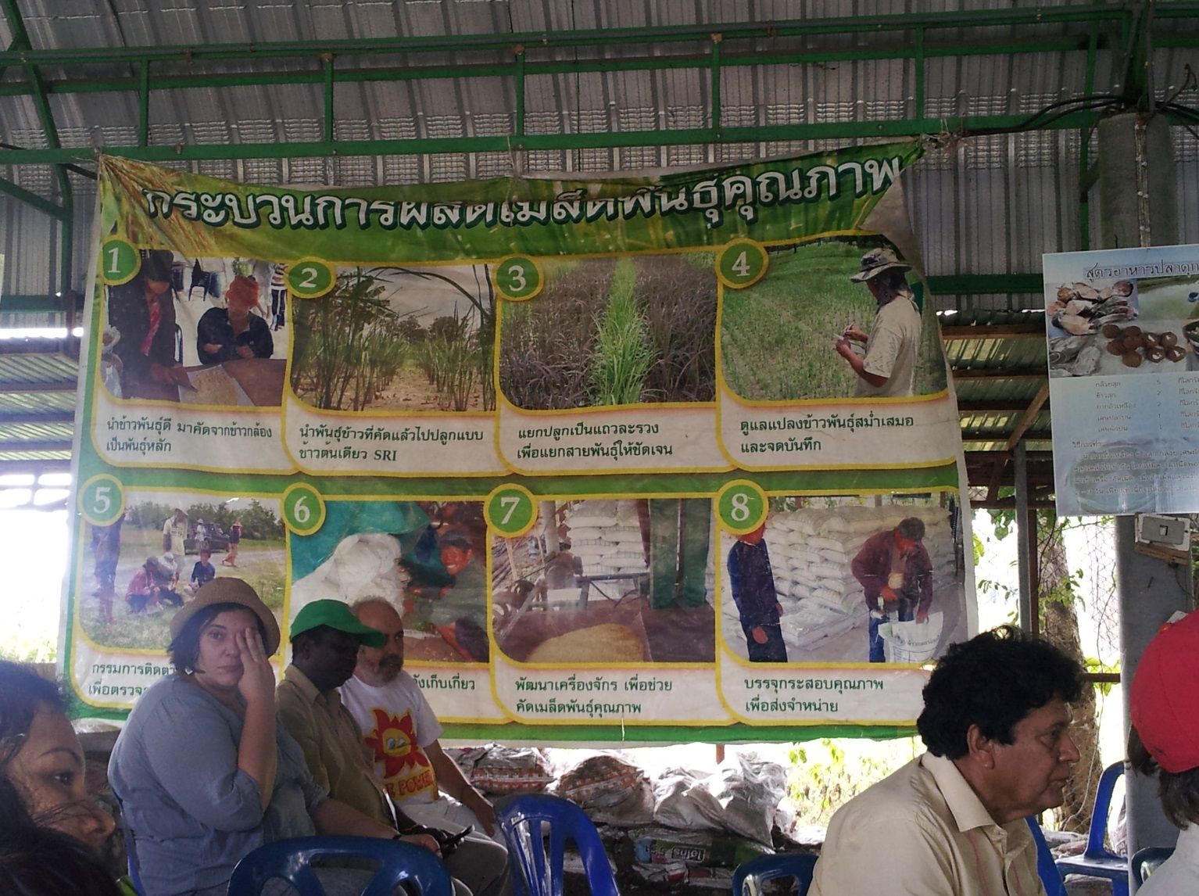
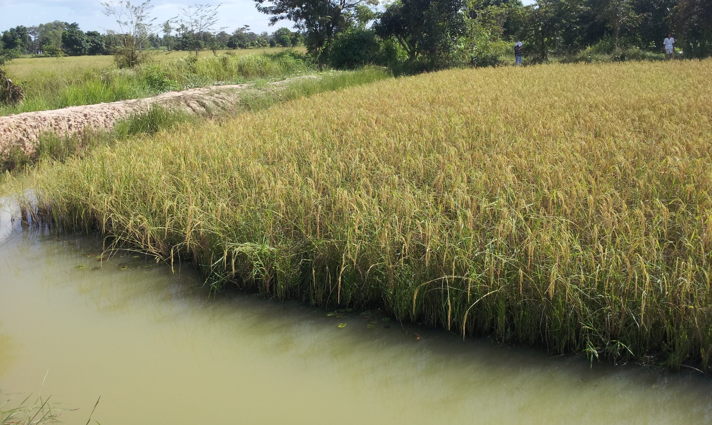

Slide 19
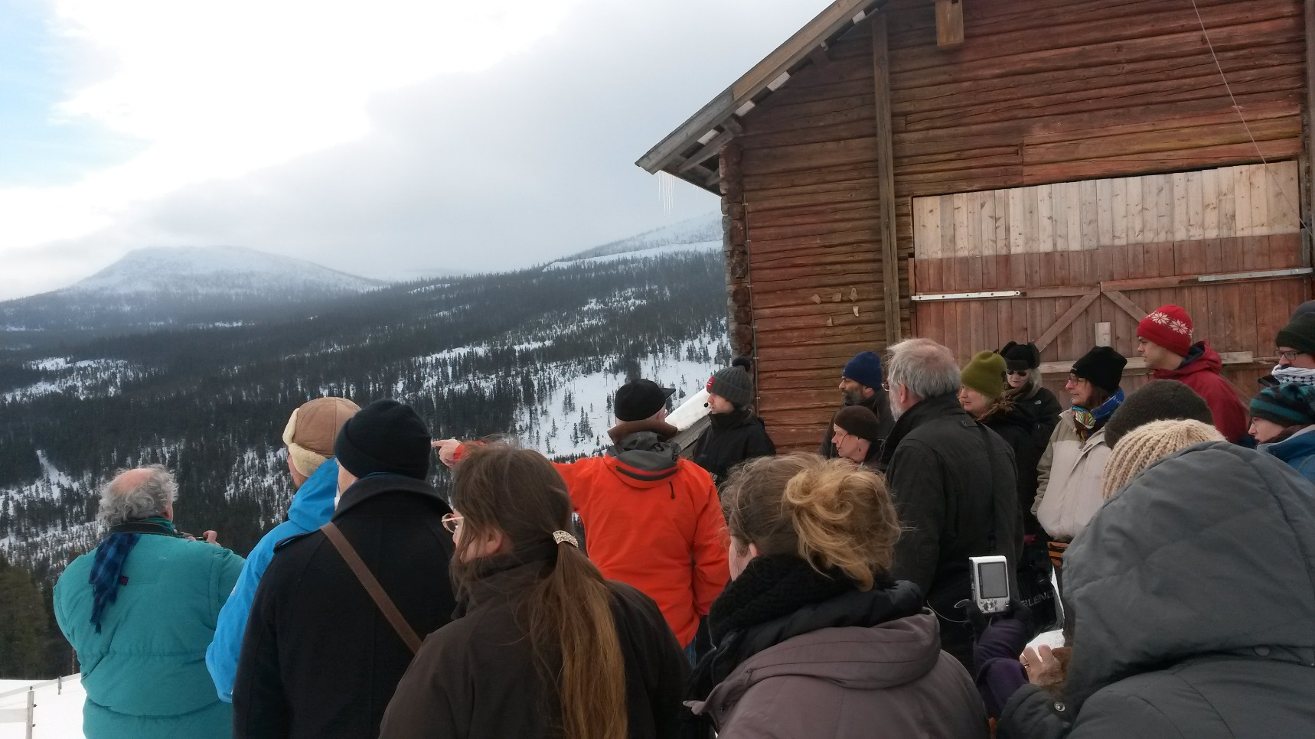
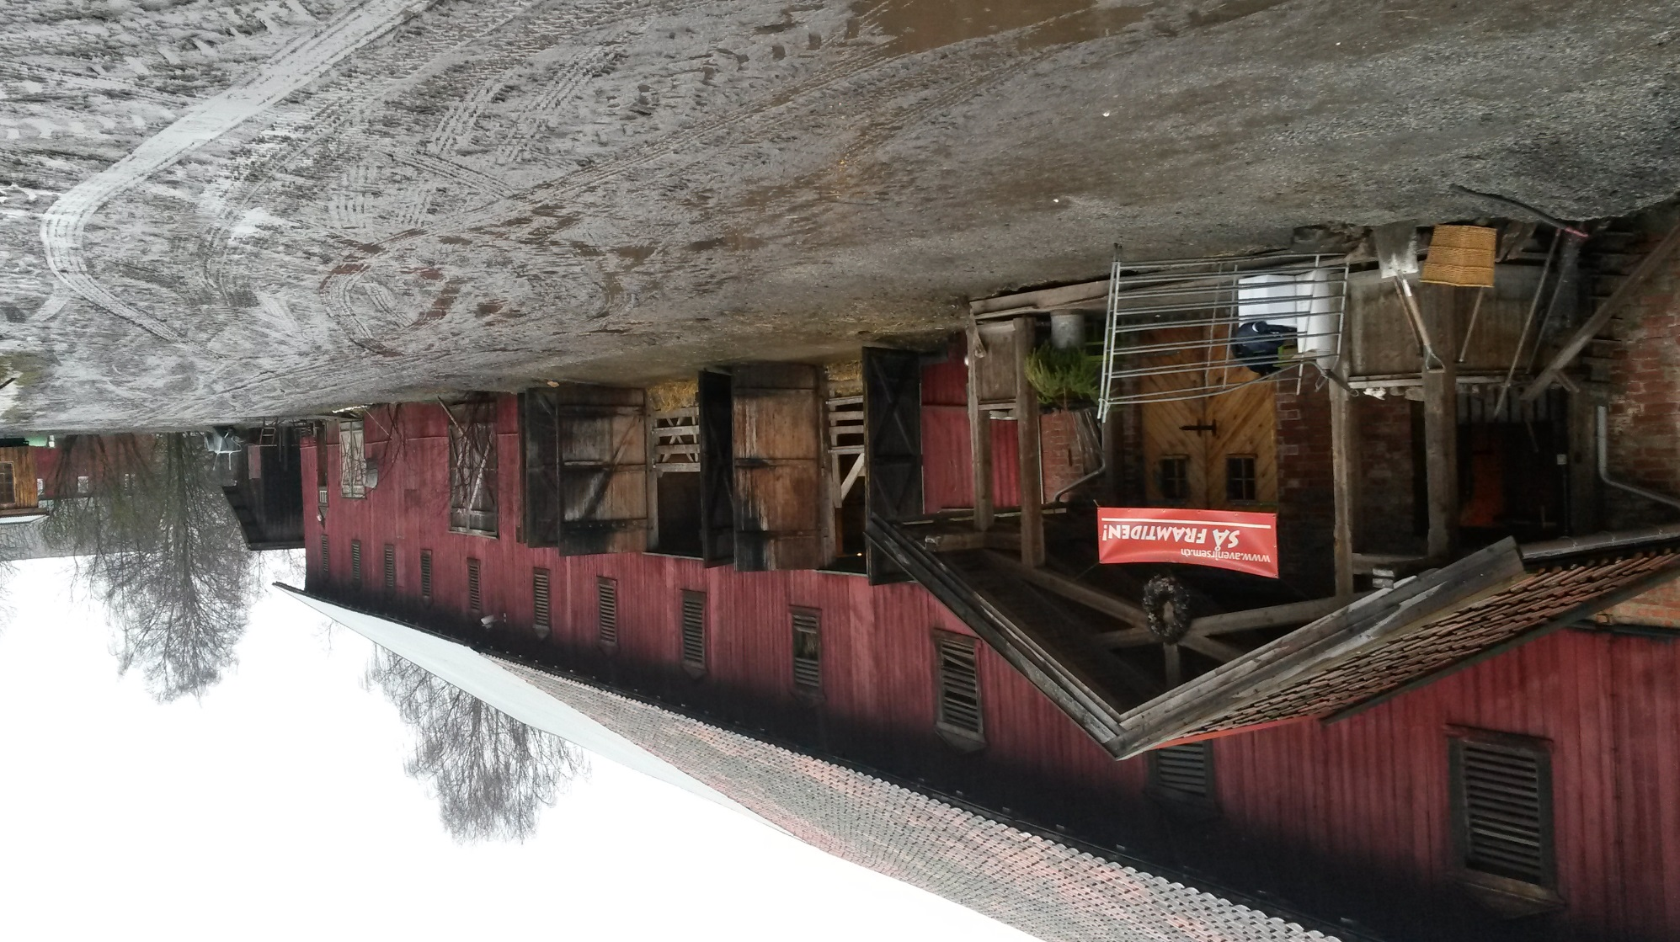

Slide 20
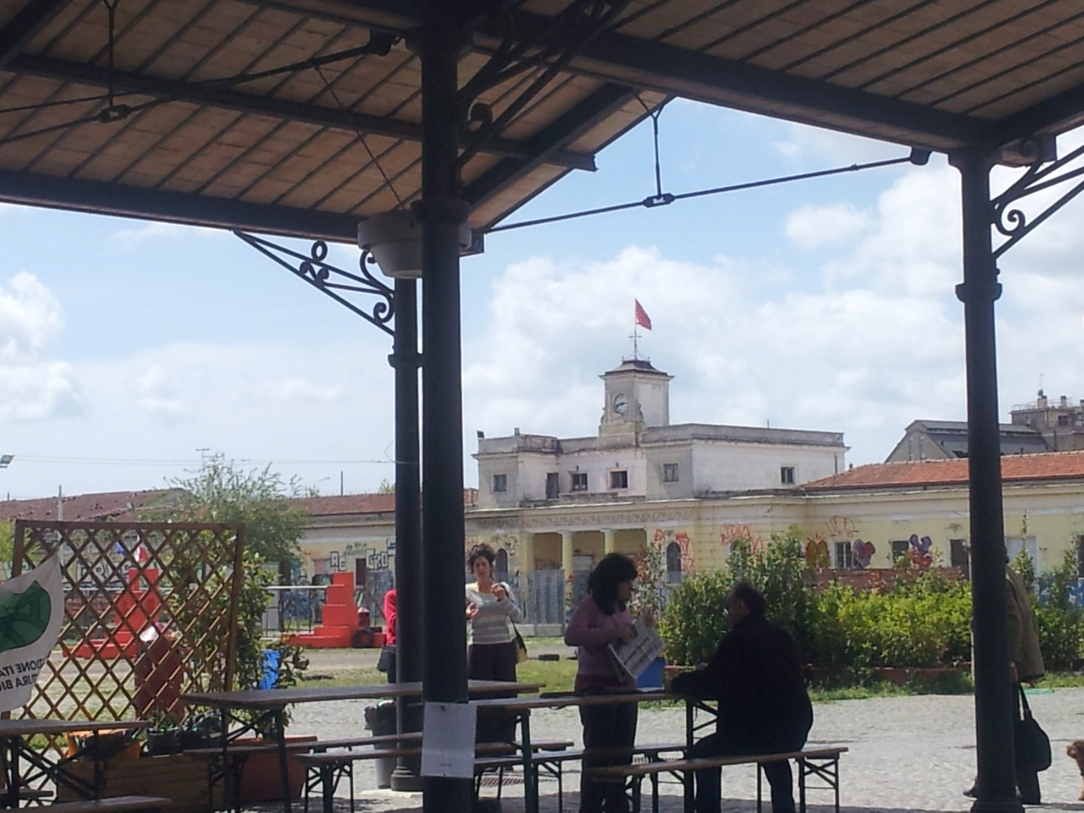
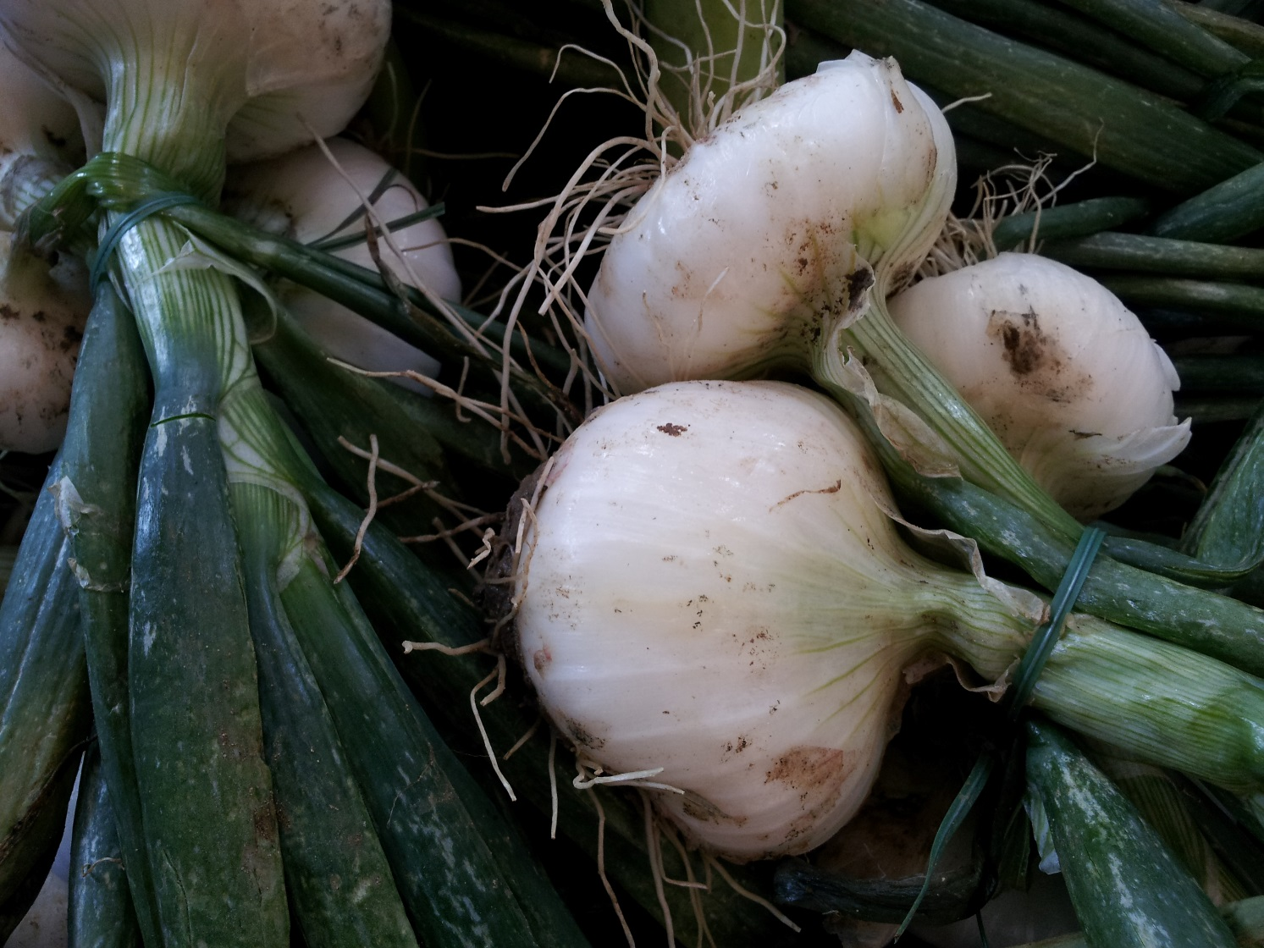
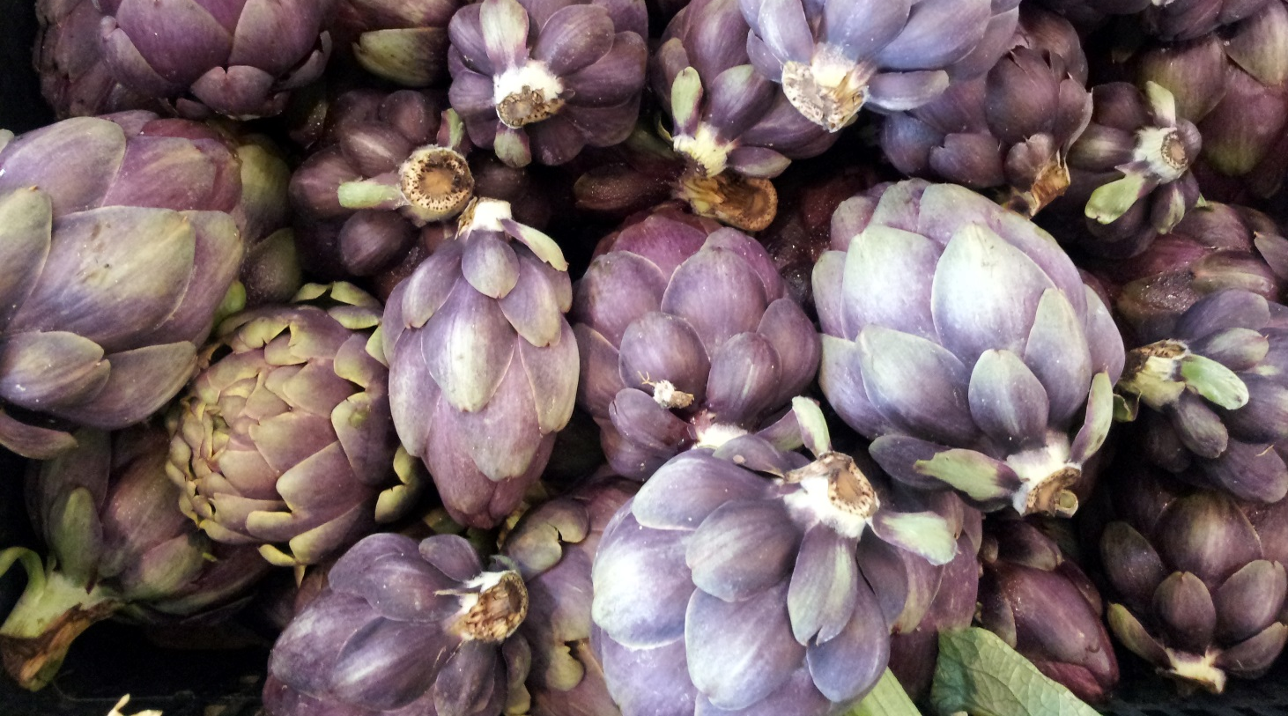

Slide 21
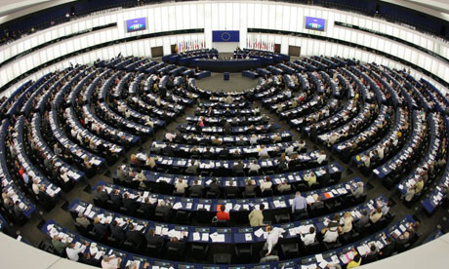
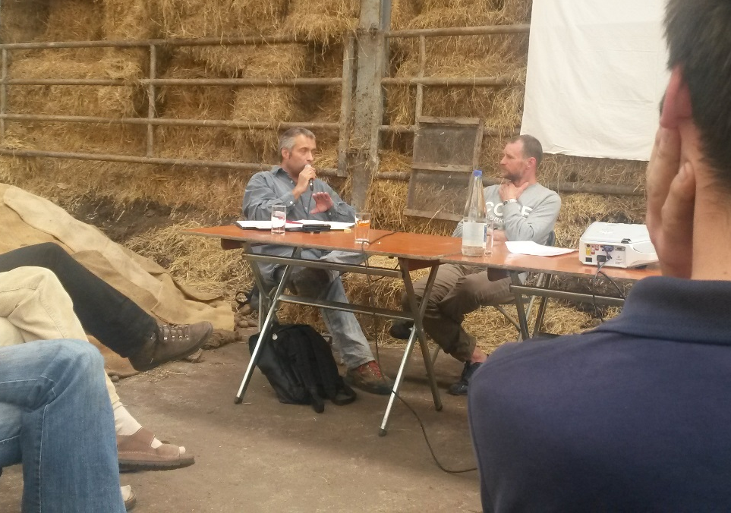
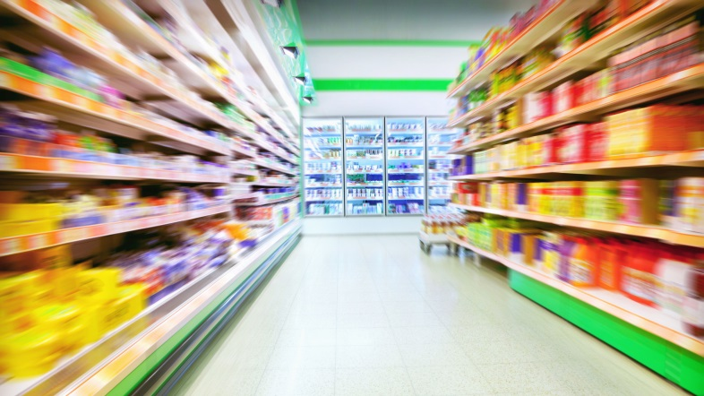

Slide 22
The action plan:
the building of local economies, sharing knowledge and building alliances between diverse constituencies.
“policy makers cannot move forward on agroecology without us. They must respect and support our agroecological processes rather than continuing to support the forces that destroy us”.
Peoples join in the collective task of jointly
constructing agroecology as part of popular struggles to build a better world, a world based on mutual respect, social justice, equity, solidarity and harmony with our Mother Earth.

Slide 23
Concrete actions in Europe:
- Building network of farmers/fishersfolk/pastoralists with specific know how and agro-ecology schools
- Policies needed to implement AE and support foodproducers (ex. Brasil)
Public conference 16 september 2015 Brussels

